Slide 1


Effects of work on health: psychosocial risk factors
Chapter 2.6

Slide 2
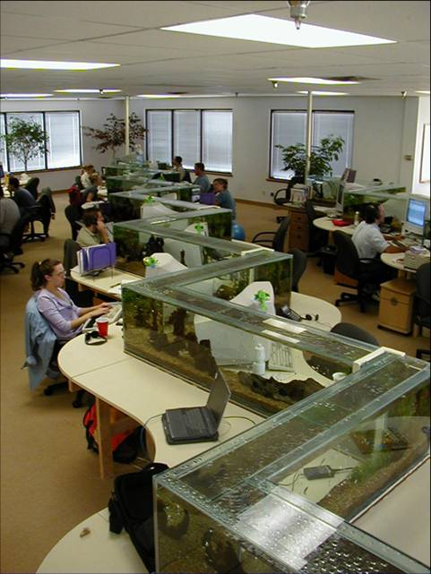
Unfavourable psychosocial work environment threatens the mental health of workers
Psychosocial work environment:
Content of work
Work demands
Social relationships at work
Organization of work
Work culture

Slide 3

Action plan: mental disorder
Physicians should always ask:
Do you have a job; if yes what kind of job, what are your work tasks?
Are you still able to work with your current health problem?
Do you feel your work may have contributed to developing or aggravating your health complaints?
3

Slide 4
Action plan: suspected work-related mental disorder
disease
exposure
other possible causes
judgment as to the disease is work related
intervention
4

Slide 5

Most common work-related mental disorders
Post Traumatic Stress Disorders
Stress-related Disorders
Depressive Disorders

Slide 6
Action plan: suspected work-related mental disorder
disease
exposure
other possible causes
judgment as to the disease is work related
intervention
6

Slide 7
Psychosocial risk factors, Job Demand Control(-Support)

Slide 8
Psychosocial risk factors, Effort-Reward Imbalance

Slide 9
Job Demands / Effort: sample questions
Do you need to work very fast?
Do you have enough work?
Do you have too much work to do?
Do you have to work often?
Does your work require a lot of concentration?
Do you need to handle many things at once?
Is your work emotionally demanding
9

Slide 10
Reward: sample questions
Do you feel you get paid enough for the work you provide?
Do you feel you get enough recognition for the work you deliver?
Does your job provide opportunities for personal growth and development?
Does your work gives you the feeling you have achieved something?
Does your job provides you opportunities for promotion?
10

Slide 11
Control: sample questions
Do you have autonomy in carrying out your work?
Can you organize your work yourself?
Do you have a say in things concerning your job?
11

Slide 12
Support: sample questions
Can you rely on your supervisor when your work is getting hard?
Do you feel your work is appreciated by your direct supervisor?
Do you believe you can count on your colleagues when your work is getting hard?
Do you feel your work is appreciated by your colleagues? No
Do you feel you have a conflict with a colleague or supervisor?
12

Slide 13

Psychosocial risk factors, Organizational Justice
Procedural justice: fairness of the decision-making procedures
Relational justice: treatment by supervisors fair, polite, and considerate?
Distributive justice: fairness of outcomes

Slide 14
Procedural justice, sample questions
Are formal procedures at your work designed to hear everyone with a stake in the decision?
Are formal procedures at your work aimed to collect accurate information necessary for the decision?
Do formal procedures at your work generate standards so that decisions can be taken consistently?

Slide 15
Relational justice, sample questions
Does your supervisor take your opinion seriously?
Does your supervisor recognizes the importance of your rights as an employee?
Does your supervisor provides timely feedback on decisions and their implications?

Slide 16
Distributive justice, sample questions
Is the salary employees receive distributed fairly in your work organization?
Are the extra benefits distributed fairly amongst employees in your work organization?

Slide 17
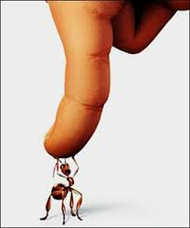
Workplace bullying
“Individual is systematically and repeatedly exposed to aggressive behavior from other organizational members”
17

Slide 18
Workplace bullying: sample question
Are you confronted with jokes or comments that you consider hurtful or inappropriate?
18

Slide 19
Other possible causes & judgment
disease
exposure
other possible causes
judgment as to the disease is work related
intervention
19

Slide 20

Other likely causes or work-related?
Consider:
Stressors outside work
Prior functioning at work
20

Slide 21
Other possible causes& judgment
disease
exposure
other possible causes
judgment as to the disease is work related
intervention
21

Slide 22
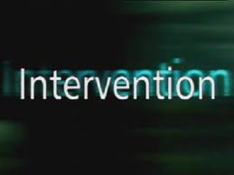
Interventions
Preventing mental disorders:
Individual:
Cognitive behavioural interventions
  Relaxation to improve coping with stressors
  Stress Management
Group and organization level interventions
  Managerial improvement programs
  Improving the psychosocial environment: participatory approach
Managing mental disorders at the work place:
  Facilitation of access to clinical treatment
  Workplace-based psychological interventions
  facilitation of navigation through the disability management system
22

